Slide 1

Flint – Financial Intelligence
Focus Sector : FinTech
Team Name : Sirius
Team Members : Sarveshvar S, Rupak B, Prajit RH, Sanjeev G, Mukesh S
Institution Name : Sri Krishna College of Engineering and Technology

Slide 2

Problem: Financial Resilience for Gig & Informal Workers
Income is unpredictable; expenses are fixed. A delivery partner can earn ₹5,000 one week and ₹3,000 the next, while rent, food, fuel, phone bills and loan repayments continue.
Core Tension
Common Behaviours
Irregular income vs. inflexible monthly obligations creates immediate cash‑flow risk.
Over-save in good weeks, nothing in bad weeks, or borrow large sums for small shortfalls.
Why Traditional Banking Fails
Products assume predictable payroll, they don’t adapt to platform-driven earnings or mixed cash/UPI flows.

Slide 3

Flint - Your Financial Co‑Pilot
Flint goes beyond balances. It answers five practical questions gig workers ask and turns insight into action with adaptive recommendations.
1
2
3
4
How am I doing?
Where am I really earning?
What should I do with my money?
Will I face a problem soon?
Smart Financial Dashboard unified view of income, expenses, safe-to-spend and upcoming bills.
Multi‑Platform Earnings Tracker + Real Profit Comparison after fuel & work costs.
Weekly Financial Plan + Smart Savings that scale with income.
Financial Weather & What‑If Simulator highlight near‑term shortfalls.
5
How much help do I need?
Emergency Recommendation + Payout Gap Protection to avoid unnecessary borrowing.
Unique twist: Protect My Income - prioritise fuel, phone & maintenance because they create tomorrow's earnings.

Slide 4
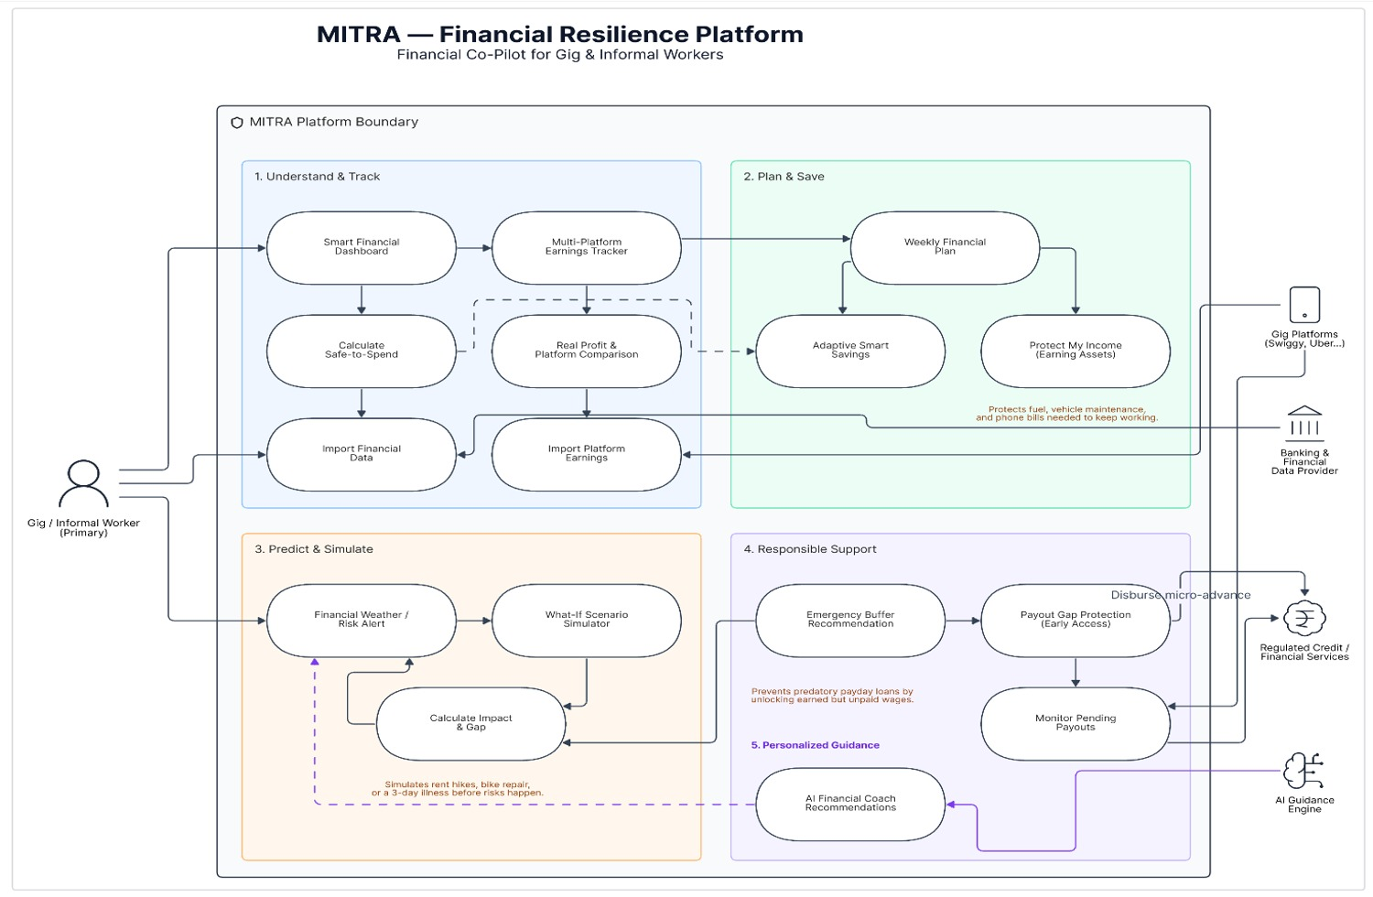

Slide 5
One Platform : 11 Financial Resilience Use Cases
Single product that moves workers from confusion to control across Understand, Plan & Save, Predict & Prepare, Protect & Recover, and Personalize.
Smart Financial Dashboard
Multi‑Platform Earnings Tracker
Real Profit / Platform Comparison
Weekly Financial Plan
Auto divides income into essentials, work costs, savings, emergency reserve and flexible spending.
Single view of income, expenses, savings, upcoming bills and safe‑to‑spend money.
Combines Swiggy, Zomato, Uber, freelance, cash and UPI in one place.
Shows profit after fuel, maintenance and other work costs.
Smart Savings
Financial Weather / Risk Alert
What‑If Simulator
Protect My Income
Adjusts recommendations up in good weeks and down in poor weeks.
Test scenarios: 30% income drop, three days off, or a ₹2,000 repair.
Reserve money for fuel, phone and vehicle maintenance to preserve earning ability.
Warns when expected income may not cover upcoming essentials.
Emergency Money Recommendation
Payout Gap Protection
Personalized Financial Coach
Early access when earnings are due but not yet paid out.
Calculates true gap before recommending borrowing.
Turns data into simple, actionable guidance the user can follow today.

Slide 6
Feasibility Analysis : Why Flint Can Work
Technical Feasibility : HIGH
Business Feasibility : HIGH
Buildable with standard components: React, SpringBoot, PostgreSQL, AI recommendation layer and visual dashboards.
Start as planning tool; monetise via partnerships: banks, NBFCs, gig platforms, insurers and premium services.
User Feasibility : HIGH
Scalability : HIGH
Interface framed around user questions: “How much can I spend?”, “Will I have enough for rent?”, “Which platform is most profitable?”
Phased rollout: Delivery riders → Drivers & freelancers → Daily‑wage workers & small merchants → Broader informal workforce → Global expansion.

Slide 7


Market Opportunity & Scalability (India)
Target Customers
Go‑to‑Market Phases
Primary: 18–45 year-old gig & informal workers, delivery partners, drivers, freelancers. Secondary: small merchants, daily‑wage workers.
Phase 1: Delivery & mobility workers
Phase 2: Freelancers, logistics, service workers
Phase 3: Broader informal / self‑employed workers
Phase 4: Global irregular‑income workforce
Market Size
~12M current gig workers (FY2024–25). Projected 23.5M by 2029–30 (NITI Aayog). Large addressable population facing income volatility and credit access challenges.
B2C launch with later B2B2C partnerships (banks, NBFCs, gig platforms, insurers) for scale and monetization.

Slide 8
Impact & Benefits — What Flint Changes
Intelligent Savings
Financial Resilience
Save according to what a worker can actually afford — adaptive, not fixed.
Prepare for a bad week before it becomes an emergency.
Better Income Decisions
Responsible Credit
Compare real profit across platforms after accounting for work costs.
Borrow only the amount truly needed — reduces long‑term debt risk.
Reduced Cash‑Flow Stress
Protects Earning Ability
Payout‑gap protection bridges the waiting period between earning and receiving money.
Prioritises fuel, phone and maintenance so users can keep working.
Personalized Guidance
Long‑Term Stability
Clear, actionable steps — not technical financial reports.
Small, repeatable choices: emergency savings → better habits → less expensive credit → resilience.

